Slide 1
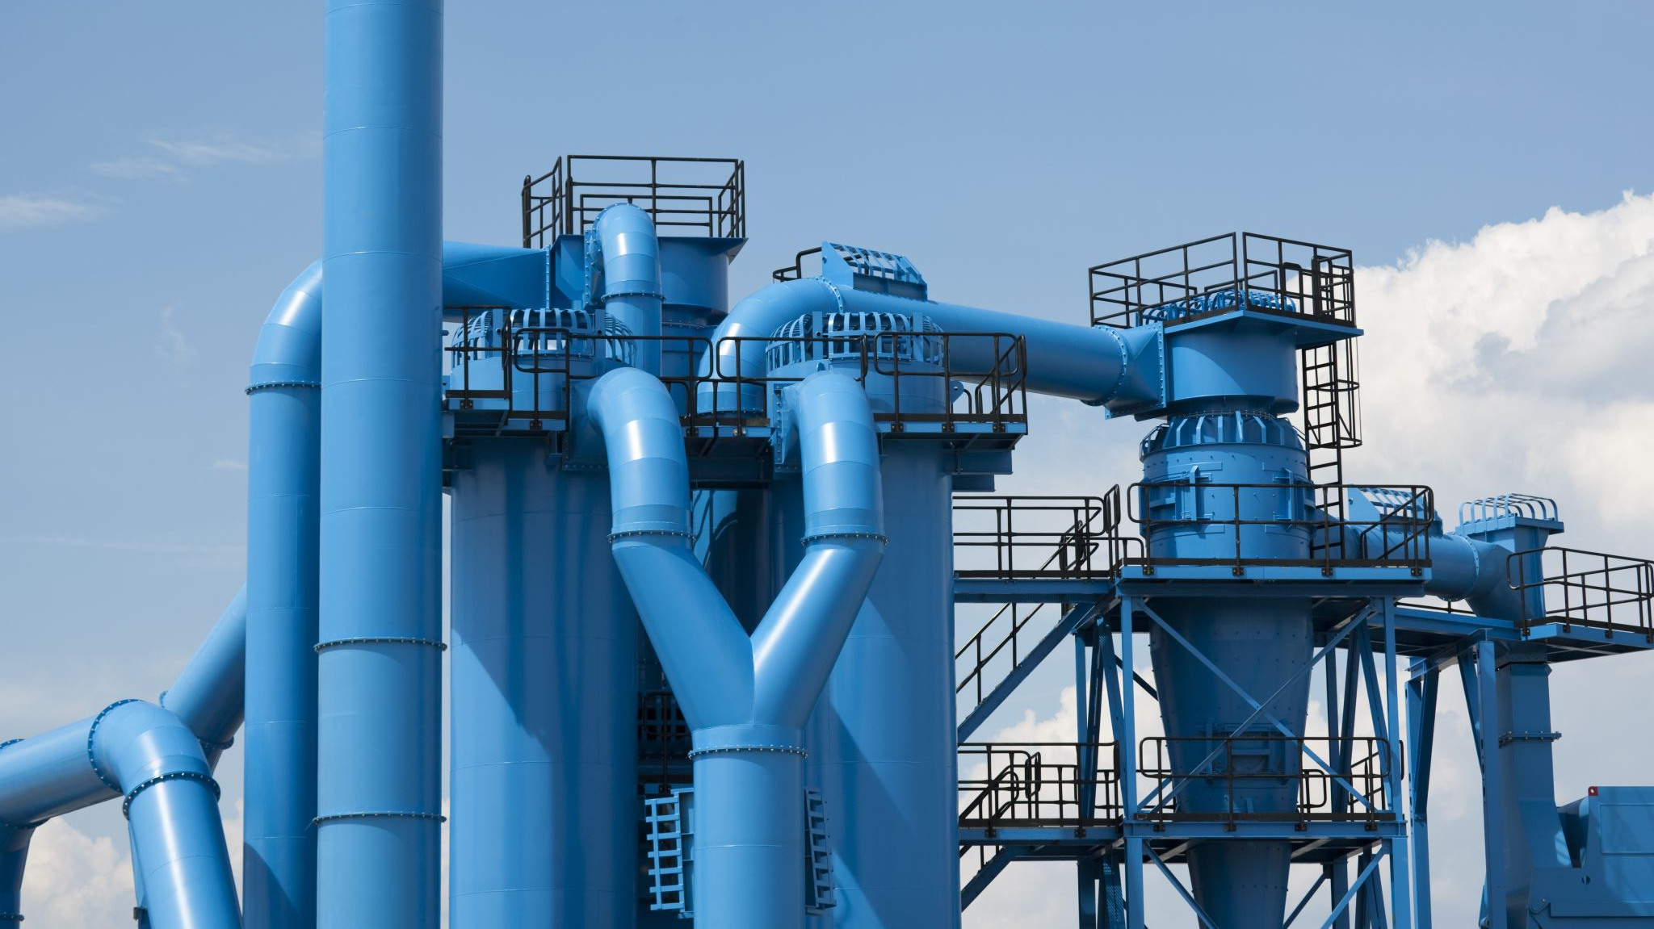
BUSINESS MANAGEMENT(OPERATION)
NAME-HIMANSHI.ANIL.DHAWAN
ROLL NO-
TOPIC-PENCIL.

Slide 2
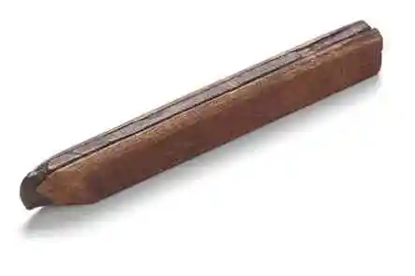
INTRODUCTION TO PENCIL:
The pencil was invented in 1795 by Nicholas Jacques conte, a scientist serving in the army of napoleon Bonaparte. The material was in the form of pure carbon that we call graphite. It was first discovered in Europe, in Bavaria at the start of the fifteen century. During the nineteenth century a major pencil manufacturing industry developed around Keswick in order to exploit the high quality of the graphite. The first factory opened in 1832, and the Cumberland pencil company has just celebrated its 175 anniversary.
The oldest pencil in the world, found in timbered house built.

Slide 3
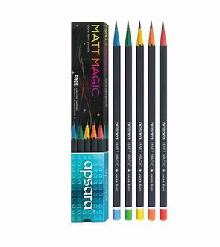
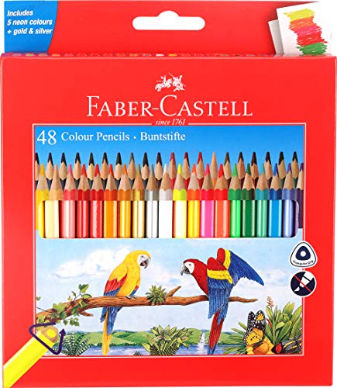
BRANDS PROMOTING THE PRODUCT-
APSARA FABER-CASTELL

Slide 4
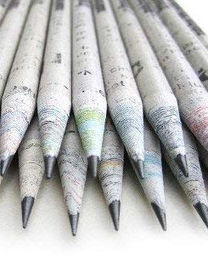
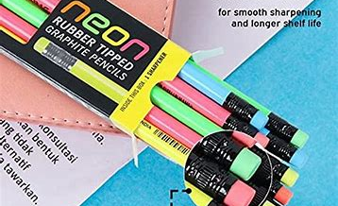
Made from recycled newspaper, non-toxic, eco-friendly, easy to use, etc.
4. GOODWILL TECH PENCIL-
3. DOMS PENCIL-

Slide 5

RAW MATERIALS REQUIRED-
WOOD.
CLAY AND GRAPHITE.
PAINT.
METAL.
RUBBER.

Slide 6
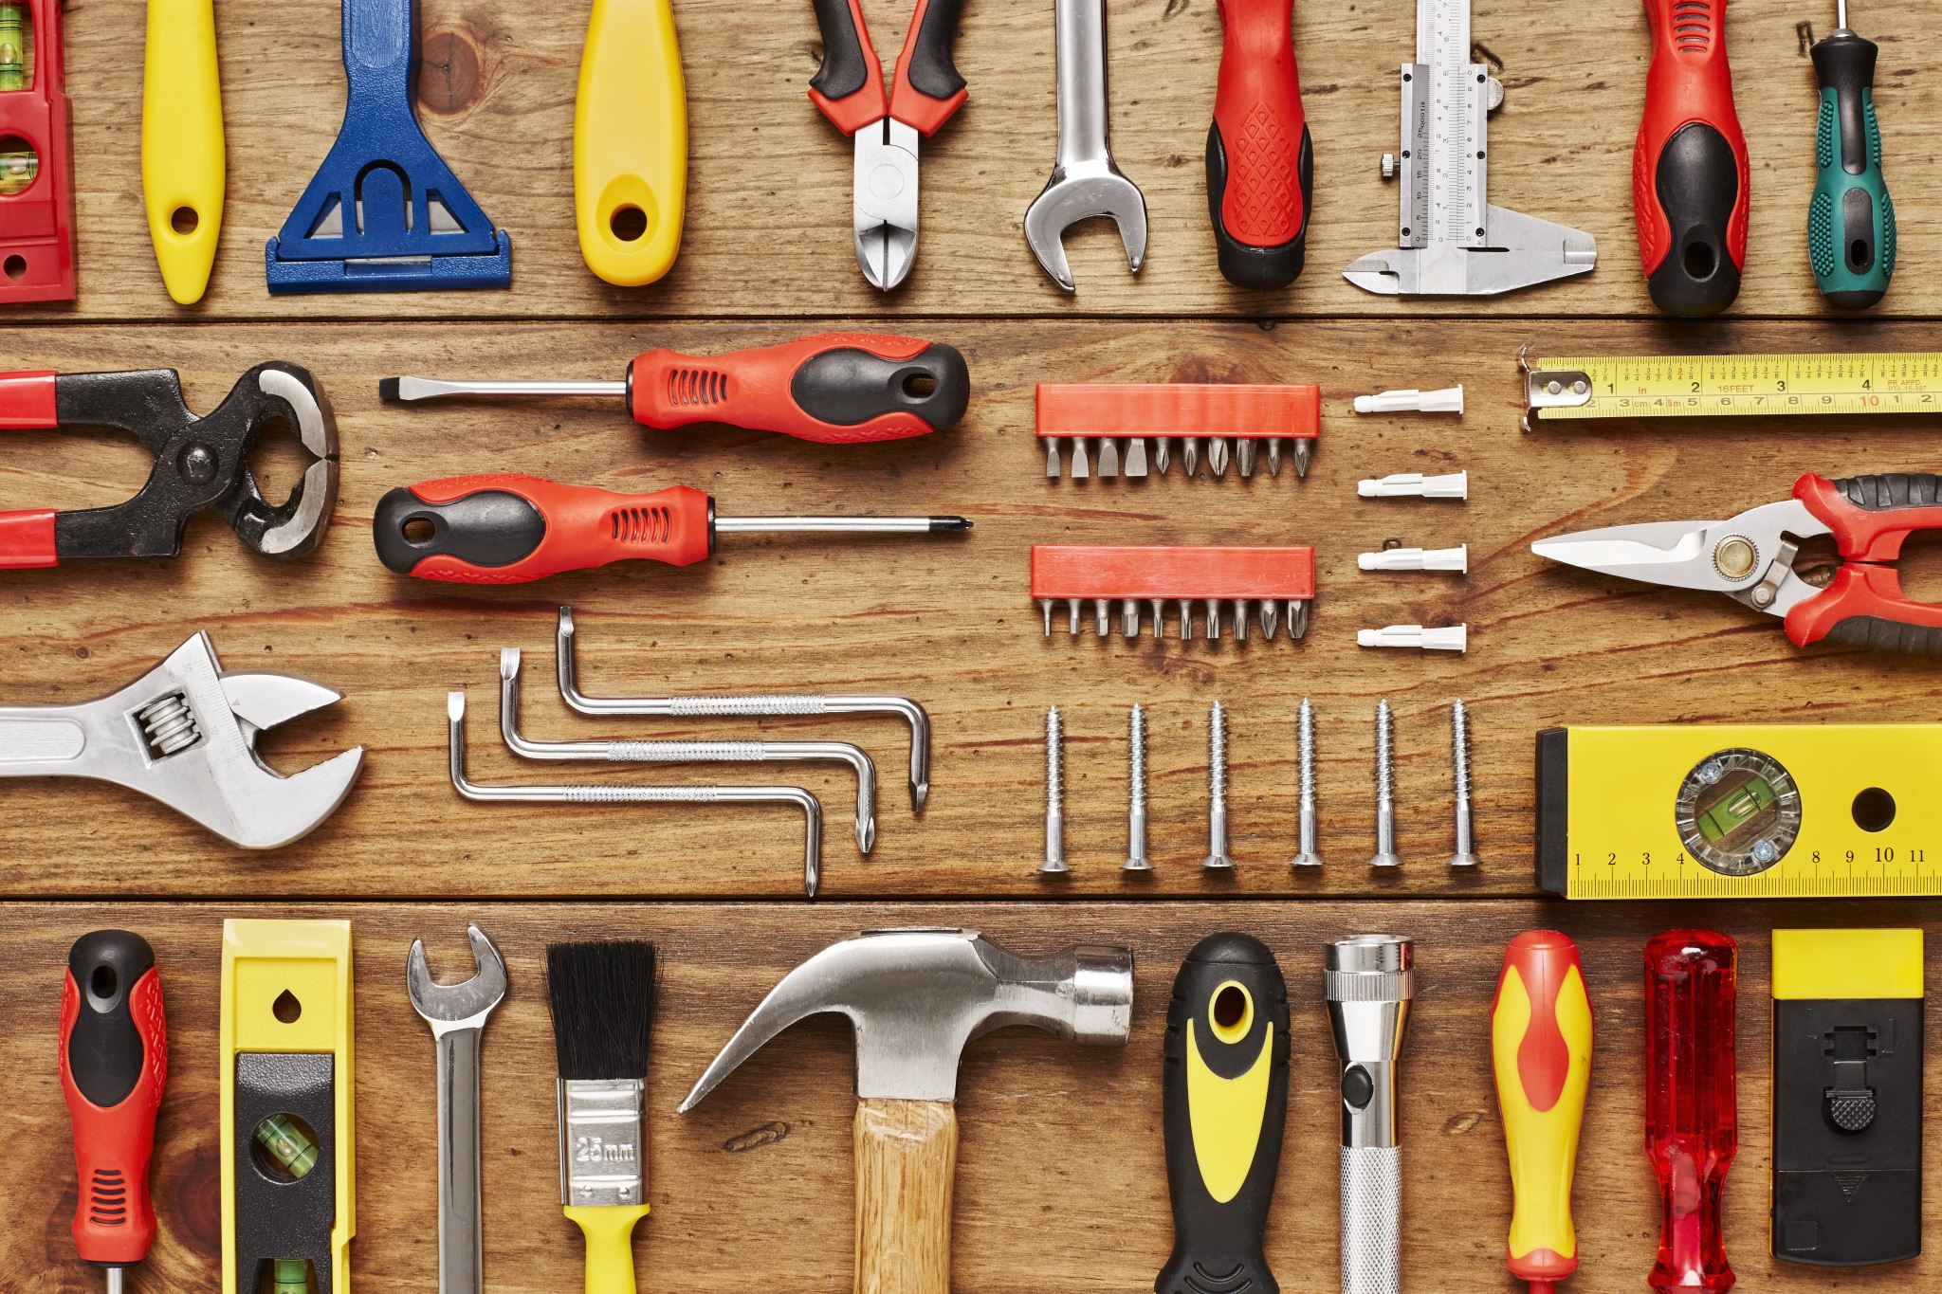
TOOLS OR EQUIPMENT USED-
CIRCULAR SAWS.
GROOVER MACHINE.
LEAD LAYER.
SHAPER.
TIPPING MACHINE.
LACQUER SPRAYER.
GIANT KILNS.
GRAPHITE MIXING MACHINE.
PAINTING AND COATING MACHINES.

Slide 7
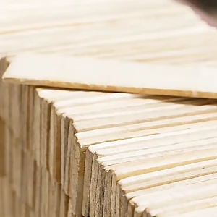
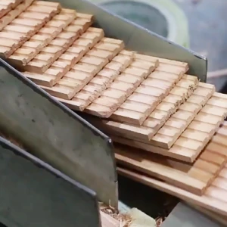
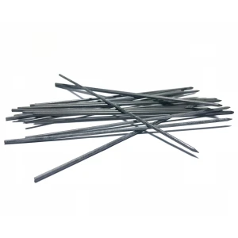
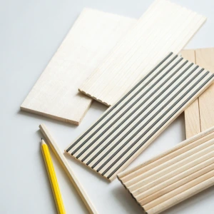
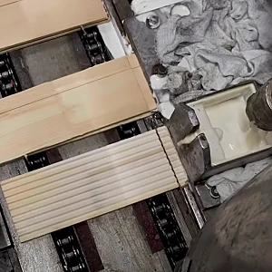
TRANSFORMATION PROCESS-
Step-1: How To Make Wood from Forest Trees.
Step-2: Wood Panel Carving.
Step-3: Graphite Lead Making.
Step-4: Making Sandwich Slats.
Step-5: Addition of the Glue.

Slide 8
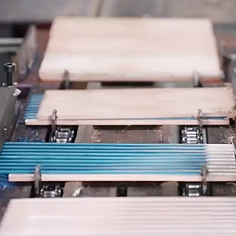
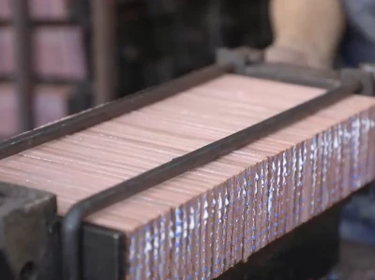
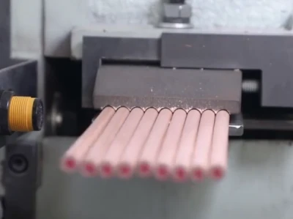

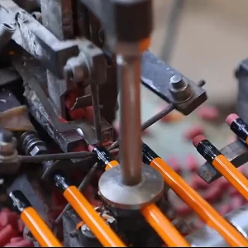
Step-6: Stacking the Lead and Wood.
Step-7: Assembling It All.
Step-8: Individual Pencil Making by Slicing the Wood.
Step-9: Quality Control.
Step-10: Final Touches.

Slide 9
PACKAGING,WAREHOUSING,TRANSPORTATION.
PACKAGING OF PENCIL CONSISTS OF-
MATERIALS, DESIGN, SIZE AND QUANTITY.
WAREHOUSING OF PENCIL CONSISTS OF-
STORAGE CONDITIONS, ORGANIZATION, etc.
TRANSPORTATION OF PENCIL CONSISTS OF-
MODES OF TRANSPORT, TRACEBILITY , LOGISTICS.
INVENTORY MANAGEMENT OF PENCIL-
STOCK MONITORING, FIFO/LIFO PRACTICES, DATA SYSTEMS.

